Slide 1






CDC Healthy Schools
Managing Chronic Health Conditions in Afterschool/Summer Programs
Barbara Pennington RN, State of Alaska
School Health Nurse Consultant

Slide 2

Introduction
Managing Chronic Health Conditions in Schools
minus
Related Pages
About 25% of children in the United States aged 2 to 8 years have a chronic health condition such as asthma, obesity, other physical conditions, and behavior/learning problems.¹ The healthcare needs of children with chronic illness can be complex and continuous and includes both daily management and addressing potential emergencies.
About 25% of children in the United States aged 2 to 8 years have a chronic health condition such as asthma, obesity, other physical conditions, and behavior/learning problems.¹ The healthcare needs of children with chronic illness can be complex and continuous and includes both daily management and addressing potential emergencies.
CDC Healthy Schools: retrieved from : https://www.cdc.gov/healthyschools/chronicconditions.htm
Notes:
Narrative:
As we know students spend many hours in school every day. Healthier students are better learners and some students may miss school or may not be at their best if they also have to manage a chronic health condition. Schools are responsible for providing academics to their students, but they can also set students up for success by addressing their health needs.

Slide 3
Introduction
Managing chronic health conditions can be especially challenging for afterschool programs.
Usually a school nurse or other medical professional is not available.
Approximately 25% of school age children have a chronic illness
Notes:
Narrative:
As we know students spend many hours in school every day. Healthier students are better learners and some students may miss school or may not be at their best if they also have to manage a chronic health condition. Schools are responsible for providing academics to their students, but they can also set students up for success by addressing their health needs.

Slide 4
Todays Topics:
1. Five most common childhood illnesses
2. Why is it important to know how to help these students?
3. Discuss medical emergencies with asthma
4. Discuss medical emergencies with allergies
5. What medications these students may have in your setting?
6. What common parent release forms are needed?
7. What policies will you need to have in place to store and administer medication for these students?
Notes:
Narrative:
As we know students spend many hours in school every day. Healthier students are better learners and some students may miss school or may not be at their best if they also have to manage a chronic health condition. Schools are responsible for providing academics to their students, but they can also set students up for success by addressing their health needs.

Slide 5
Most common childhood illnesses
Asthma
Allergies
Seizures
Diabetes
Poor Oral Health
Notes:
Narrative:
As we know students spend many hours in school every day. Healthier students are better learners and some students may miss school or may not be at their best if they also have to manage a chronic health condition. Schools are responsible for providing academics to their students, but they can also set students up for success by addressing their health needs.

Slide 6
Prevalence of Chronic Illnesses
Estimated percentage of U.S. students affected*
Asthma 7.3-9.5% of all children: 18% of children living in poverty
Food allergies 4.0%
Seizure disorders 0.7%
Diabetes 0.3% (Includes type 1 and type 2)
Poor oral health 15.6%[untreated dental caries (cavities)]
Centers for Disease Control and Prevention (2017). Chronic Health Conditions and Academic Achievement
Estimates reflect populations from various studies—specific age groups may vary
Notes:
Narrative:
As we know students spend many hours in school every day. Healthier students are better learners and some students may miss school or may not be at their best if they also have to manage a chronic health condition. Schools are responsible for providing academics to their students, but they can also set students up for success by addressing their health needs.

Slide 7
Why is it important to know how to help these students?
They will be in your afterschool or summer program
Knowing medical information ahead of time will help you avoid possible medical emergencies
You can develop a medical plan with your staff
Know what food to serve and snacks that will be safe for your students with allergies
Many food allergies do not occur until age 3 or 4 and many times in older children too.
Notes:
Narrative:
As we know students spend many hours in school every day. Healthier students are better learners and some students may miss school or may not be at their best if they also have to manage a chronic health condition. Schools are responsible for providing academics to their students, but they can also set students up for success by addressing their health needs.

Slide 8
Provide a safe environment
Provide a safe physical environment, both outside and inside your buildings. Provide healthy snacks
Ensure that foods are labeled and that menus are available to students and their families. In addition, food allergens, such as peanuts, should be prohibited in the afterschool programs
Encourage all students to participate in physical activity, regardless of ability, unless medical needs prevent it.
Centers for Disease Control and Prevention (2017). Addressing the Needs of Students with Chronic Health Conditions: Strategies for Schools
Notes:
Narrative:
As we know students spend many hours in school every day. Healthier students are better learners and some students may miss school or may not be at their best if they also have to manage a chronic health condition. Schools are responsible for providing academics to their students, but they can also set students up for success by addressing their health needs.

Slide 9
Emergency Care Plans
A detailed set of actions needed for an individual student when there is a risk of predictable medical emergency related to his/her chronic condition.
The plan is written in layman’s terms to include and share with school staff that may have potential responsibilities in an emergent event for the student.
Afterschool programs can request a copy of the plans
Notes:
Narrative:
As we know students spend many hours in school every day. Healthier students are better learners and some students may miss school or may not be at their best if they also have to manage a chronic health condition. Schools are responsible for providing academics to their students, but they can also set students up for success by addressing their health needs.

Slide 11
Seizure First Aid
Make sure student is safe, move all objects away (furniture etc.)
Remove all other students out of the room
Place the student on their side
Time the seizure
Monitor breathing
Protect the student from injury, do not restrain or use force
Know when to call for emergency services, 911
Follow the student’s seizure action plan (previously diagnosed seizure disorder)
If a first known seizure, activate emergency services immediately

Slide 12
Asthma
••• is a chronic, often lifelong condition of the airways.
••• has no known cure.
••• results in 15 deaths a day in the U.S..
••• can be controlled through effective asthma
management and reduction of environmental triggers.
Asthma impacts afterschool programs because...
••• it is a leading cause of school absences.
(over 14 million school days lost/year in the U.S.)
••• Children with asthma need to have their rescue inhalers available and staff need to know how to help students use them.

Slide 13
Asthma Action Plan for Home, School and Afterschool
Asthma Action Plan for Home & School
Name: Birthdate:
Asthma Severity: Intermittent Mild, seldom needs an inhaler
Moderate Persistent: uses an inhaler on a regular basis
Severe Persistent He/she has had many or severe asthma attacks and /or have been hospitalized for asthma
It is best to use a spacer with inhalers as directed.
Controller Medicine(s): usually not needed in afterschool program
(make sure you have a rescue inhaler and not a controller inhaler)
Rescue Medicine: Albuterol puffs every four hours as needed
Exercise Medicine: Albuterol puffs 15 minutes before activity as needed

Slide 14
Asthma
••• Asthma can be fatal, even in mild cases, and symptoms are often sudden and unexpected.
••• While asthma affects each individual differently children
with asthma can lead a normal life at home and at school by
managing their asthma successfully and avoiding things
that make it worse.
••• For the purpose of this presentation we define an asthma
episode as a flare-up of asthma that is not life-threatening
and may be controlled with medication and help from adult
staff support.
…. We define an asthma emergency as an asthma
episode that cannot be controlled, may be life threatening,
and needs immediate attention.

Slide 15
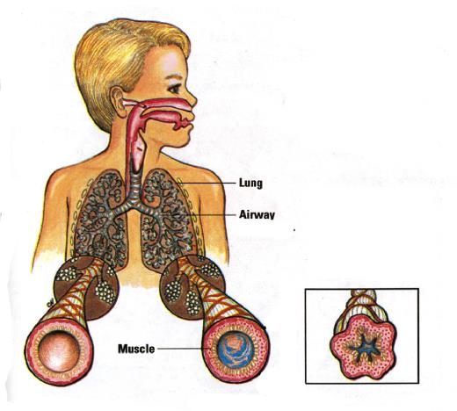
During an asthma episode:
••• The airways swell
••• Excess mucous production clogs airways
••• Muscles around the airways tighten

Slide 16
Symptoms of Asthma
Each individual has his/her own set of symptoms. If you know a student has asthma, or suspect they do, watch for these warning signs to indicate uncontrolled asthma or a potential asthma episode:
••• Cough (persistent or with activity)
••• Wheeze
••• Shortness of breath
••• Student reports tightness in the chest
••• Consistent use of rescue inhaler (monitor students who self-carry rescue inhalers)

Slide 17
Asthma Triggers
••• An asthma trigger is anything that can bring on an
asthma episode or make it worse.
••• Everyone’s triggers can be different.
••• Multiple triggers can have a cumulative effect.
••• Some students have several triggers
Other things that aggravate asthma
••• Colds or respiratory viral infections
••• Allergic reactions
••• Strong emotions (stress, crying or laughing hard)

Slide 18

Asthma Triggers in School/Afterschool Settings:
••• chalk dust
••• classroom animals
••• mold, mildew
••• strong odors
(scented body products, markers,
air fresheners, cleaning supplies, etc.)
••• art class and shop materials
••• cold temperatures
••• output from idling school buses and vehicles
••• dust mites
••• pollens
••• smoke
••• pests

Slide 19
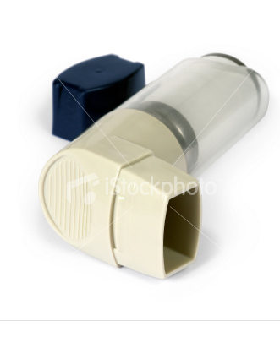
Medications There are two basic types:
1. Quick Relief | ALBUTEROL
••• Used to reduce asthma symptoms, before
exercise, and during an emergency!
••• Ideally, everyone with asthma has access
to quick relief medication at school
2. Controller
  ••• Ideally, used at home daily to prevent inflammation and episodes.
  ••• Not prescribed for everyone with asthma
  and often under utilized.

Slide 20
Students with asthma in afterschool programs
••• Students with known asthma may need to take their
medications when experiencing asthma symptoms.
••• If child has medication in class (self-carry law allows
this), administer and notify parent
Make sure the student is taking his/her inhaler properly
Preventing asthma episodes during exercise
••• Some students need to use quick relief medication (albuterol)
15 minutes prior to activity. Follow your asthma action plan
••• Keep quick relief inhaler available and accessible during
activity/physical education class.
••• If symptoms occur during activity, stop exercise
and utilize quick relief medication, if necessary.

Slide 21
For an asthma emergency:
Always stay calm, keep student upright,
and don't leave the student alone!
Call 911 if student is having an asthma emergency and has no quick relief medication.
Call 911 if student is having an asthma emergency and is unable to control it with their quick relief medication (continued shortness of breath, straining to breathe, symptoms getting worse).
Call 911 immediately if a student can't walk or talk, or a student's lips or nails are blue.
Remember, never leave the student alone!

Slide 22
What Afterschool Programs Can Do to
Reduce Asthma Triggers:
••• Keep Heating, Ventilation, and Air Conditioning system
(HVAC) running when people are in the room.
••• Make sure to avoid extremely cold weather (below zero)
••• Keep building free of condensation, mold/mildew and
maintain average zone for humidity.
••• Avoid scented products (Plug-Ins, air fresheners,
cleaning products, perfumes, etc.)

Slide 23
What Schools/Afterschool Programs Can Do to
Reduce Asthma Triggers (Continued):
••• Minimize clutter and store art supplies and cleaning
supplies in closed containers.
••• Clean classrooms daily, remove trash, and keep free of
pests and vermin.
••• Minimize use of carpets and increase use of tile and
hardwood floors.
••• Use fake or low allergen plants.
See http://calasthma.org/resources/show_resource/448/
••• Have a “no pets allowed” rule or minimize exposure.

Slide 24
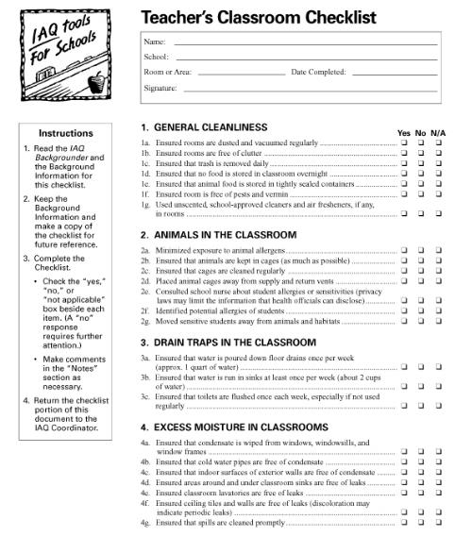
Do a walkthrough to review your after school environment.
This is an example of an Indoor Air Quality (IAQ) checklist that programs can use to review their classrooms and other facilities.
Source: U.S. Environment Protection Agency’s Tools for Schools Program
http://www.epa.gov/iaq/schools/

Slide 25
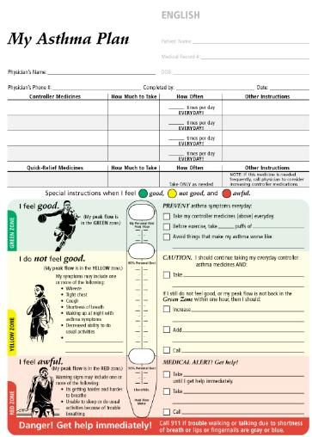
EXAMPLE
Asthma Action Plans
Ideally, every student with asthma has a plan on file with their afterschool program from their doctor and parent/guardian that indicates their:
••• asthma diagnosis
••• medication plan
••• triggers
••• emergency information
Ask the parent to provide you the
Asthma Action Plans they use in school for your afterschool program

Slide 26
Food Allergies
What foods cause allergic reactions?
Food allergies occur when the body's immune system overreacts to substances in food you have eaten,
triggering an allergic reaction. Food allergies are more common in young children than in adults.
Milk, eggs, peanuts, tree nuts, fish,
shellfish, wheat, and soy cause most problems in children

Slide 27
Life Threatening Allergies
Ask parents to provide you with an allergy care plan
Know what the child’s allergy is and let all staff that work with the student be aware of food allergies
Make sure to have a plan for alternative snacks, let parents know if you are serving snack that their child cannot eat, so they can bring in a non-allergy alternative
Know the signs of anaphylaxis
Have an allergy care plan and medication available
Be trained on how to use the emergency medication
Practice

Slide 28
What is Anaphylaxis?
Why is it an Emergency?
A severe allergic reaction when the immune system is exposed to a substance that it mistakenly believes is harmful
Signs will appear in multiple parts of the body
Without epinephrine treatment, it can be fatal
Anaphylactic shock is when the anaphylaxis causes severe low blood pressure or shock

Slide 29
Some Causes of Anaphylaxis
Food
  Peanuts, tree nuts, fish, shellfish, cow’s milk, soy, egg, sesame seeds
Insect stings
Medications
  Penicillin, aspirin, nonsteroidal anti-inflammatory
Natural rubber latex

Slide 30
Symptoms of Anaphylaxis
Only a few symptoms may be present
THROAT: tightness/closure, hoarseness, itching, difficulty swallowing, change in voice, high-pitched breathing
LUNG: difficulty breathing, shortness of breath, coughing, wheezing, chest tightness
HEART: Weak pulse, irregular pulse, dizziness, fainting
MOUTH: Itching, swelling of lips, tongue, and/or back of throat
SKIN: Itching, redness, swelling, hives (a red, raised, itchy skin rash), itching of outer ear canals
EYES: Redness, swelling, tearing, itching
GUT: May have accompanying vomiting, diarrhea, stomach cramps

Slide 31
What is Epinephrine?
Epinephrine is a chemical that narrows blood vessels and opens airways in the lungs.
These effects can reverse severe low blood pressure, wheezing, severe skin itching, hives, and other symptoms of an allergic reaction.
Epinephrine injection is used to treat severe allergic reactions (anaphylaxis) to insect stings or bites, foods, drugs, and other allergens.

Slide 32
Emergency Care Plan When Students have their own Epinephrine
Know which students have severe allergies
Know what symptoms to look for
Decide if anaphylaxis and administer personal dose of epinephrine by auto-injector quickly (by self or by trained personnel) while having someone else call 911
If possible, have person sit down or lie down
May need a second dose of epinephrine in 10-20 minutes if still ill or worsening
Transport to hospital by emergency medical responders
Call parent/guardian
Inform afterschool/summer school administrators

Slide 33
Giving Epinephrine by Auto-Injector
Follow instructions in manufacturers’ package insert
(and training video if you have one, or can assess online)
How to hold
  Form a fist around the center of the injector
  Pull off the cap protecting the needle right before using
How to Use
  Hold the tip with the needle near the upper outer thigh (always apply to thigh)
  Swing and jab into the outer thigh (thru clothes if necessary)
  Hold injector in place and count to 10

Slide 34
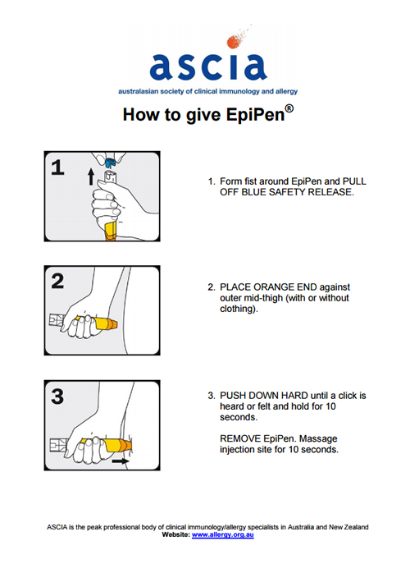

Slide 35
Document Events
Document
  Time and dose of epinephrine given
  Describe symptoms before & after epinephrine
  Write names of people involved in giving epinephrine and in caring for person
Do not discard Auto-injector in regular trash
  Give to emergency responders with person’s name and time it was used written on it

Slide 36
What polices does your program have?
.What common parent release forms are needed for students with chronic illnesses?
What policies will you need to have in place to store and administer medication for these students?
Examples of forms will be available

Slide 37
Resources
The State of Alaska website for School Health /School Nursing http://dhss.alaska.gov/dph/wcfh/pages/school/default.aspx
Resources for many chronic health conditions: Includes training guides for medication administration, diabetes management, emergencies, Infectious disease management, asthma management
State School Health Nurse Consultant: Barbara Pennington
Phone 907-269-7368 Barbara.pennington@Alaska.gov
CDC Healthy Schools: retrieved from : https://www.cdc.gov/healthyschools/chronicconditions.htm
FARE: Food Allergy Network https://www.foodallergy.org/containscourage
SAMPRO: School Based Allergy Management Program
https://www.hipxchange.org/SAMPRO

Slide 38
Thank you for attending!
https://www.surveymonkey.com/r/GLZMMNN
Barbara Pennington
State School Health Nurse Consultant Phone 907-269-7368 Barbara.pennington@Alaska.gov

